Slide 1

Edison Wi-Fi
hello@hybus.net

Slide 2
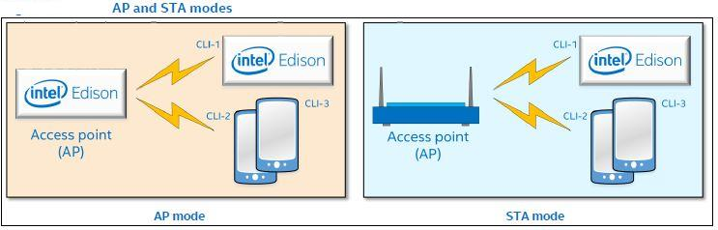
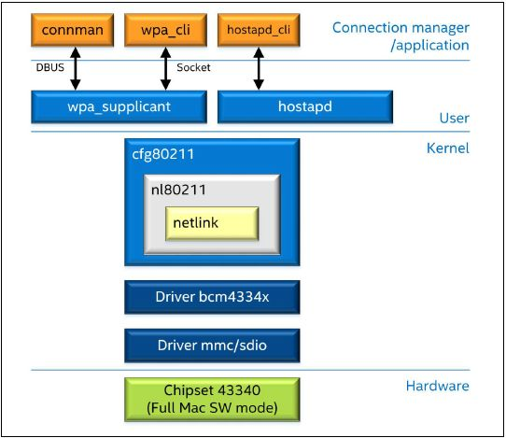
Wi-Fi
Interface : Wlan0
802.11 a/b/g/n support. WEP encryption. WPA encryption. WPA2 encryption.
Station(STA) mode 와 Access point(AP) mode 구분
Features
- 802.11 a/b/g/n support.
- WEP encryption.
- WPA encryption.
- WPA2 encryption.
- STA mode.
- AP mode.
- Wakeup on Wi-Fi
- Multirole
- Wi-Fi Direct/P2P

Slide 3
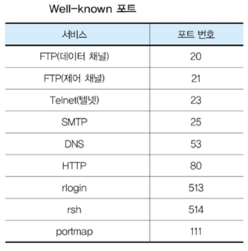
Simple WebServer Wi-Fi
Webserver 필요 변수 선언
- ssid, pass, port number 선언
- use to WPA Encryption
- use to 70 port number
#include <SPI.h>
#include <WiFi.h>
char ssid[] = "YourNetwork"; // your network SSID (name)
char pass[] = "password"; // your network password
int keyIndex = 0; // your network key Index number (needed only for WEP)
int status = WL_IDLE_STATUS;
WiFiServer server(70);
source
Notice.
WPA/WPA2 암호화 방식인 네트워크를 사용하였고 WPA 암호방식은 고정된 하나의 키를 사용하기 때문에 키 목차가 필요가 없어서 0을 대입하지만 WEP 암호방식은 4가지의 다른 키를 가지기 때문에 key index를 이용하여 어떤 ap 비밀키를 사용할 지정해줘야 된다. 즉 SSID, password, key number를 설정
WiFiServer servers() 변경 -> /usr/lib/edison_config_tools edison-config-server.js
※ 80포트의 경우 node.js 서버에서 사용

Slide 4
Simple WebServer Wi-Fi
void setup
Serial.begin(9600);
pinMode(9, OUTPUT);
if (WiFi.status() == WL_NO_SHIELD){
Serial.println("WiFi shield not present");
while(true); // don't continue
}
String fv = WiFi.firmwareVersion();
if( fv != "1.1.0" )
Serial.println("Please upgrade the firmware");
source
Notice.
연결상태와 펌웨어 상태를 확인하여 연결이 되어 있지 않거나 최신버전이 아닐 경우 에러메시지를 출력하고 연결되어 있지 않을 경우 동작이 중지

Slide 5
Simple WebServer Wi-Fi
void setup
while ( status != WL_CONNECTED)
{
Serial.print("Attempting to connect to Network named: ");
Serial.println(ssid); // print the network name (SSID);
// Connect to WPA/WPA2 network. Change this line if using open or WEP network:
status = WiFi.begin(ssid, pass);
// wait 10 seconds for connection:
delay(1000);
source
Notice.
모듈에 문제가 없다면 연결 시도
연결하고 있는 네트워크의 이름을 시리얼 모니터에 출력

Slide 6

Simple WebServer Wi-Fi
void setup
server.begin(); // start the web server on port 70
printWifiStatus(); // you're connected now, so print out the status
source
Notice.
Web서버를 구동, 현재 Wi-Fi상태정보 출력
Wi-Fi상태 : SSID, IP, Address, RSSI정보

Slide 7
Simple WebServer Wi-Fi
void roop
WiFiClient client = server.available(); // listen for incoming clients
if (client) { // if you get a client,
Serial.println("new client");
String currentLine = ""; // make a String to hold incoming data from the client
while (client.connected()) { // loop while the client's connected
if (client.available()) { // if there's bytes to read from the client,
char c = client.read(); // read a byte, then
Serial.write(c); // print it out the serial monitor
if (c == '\n') { // if the byte is a newline character
if (currentLine.length() == 0) {
client.println("HTTP/1.1 200 OK");
client.println("Content-type:text/html");
client.println();
source
Notice.
Client 활성화, 접속상태 출력

Slide 8
Simple WebServer Wi-Fi
void roop
client.println("HTTP/1.1 200 OK");
client.println("Content-type:text/html");
client.println();
source
Notice.
HTTP 1.1 프로토콜 시작
if (currentLine.endsWith("/H")) {
digitalWrite(9, HIGH); // GET /H turns the LED on
}
if (currentLine.endsWith("/L")) {
digitalWrite(9, LOW); // GET /L turns the LED off
}
source
Notice.
Web페이지를 통해 LED Control

Slide 9
Simple WebServer Wi-Fi
printWfiStatus
Serial.print("SSID: ");
Serial.println(WiFi.SSID());
IPAddress ip = WiFi.localIP();
Serial.print("IP Address: ");
Serial.println(ip);
long rssi = WiFi.RSSI();
Serial.print("signal strength (RSSI):");
Serial.print(rssi);
Serial.println(" dBm");
source
Notice.
Wi-Fi 연결정보 표시
Wi-Fi name, RSSI(8bit, 0x00~0xFF, dBm)

Slide 10
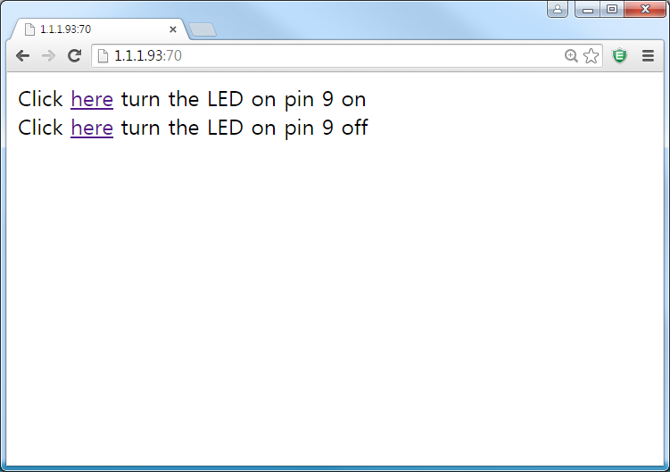
Simple WebServer Wi-Fi
Run

Slide 11
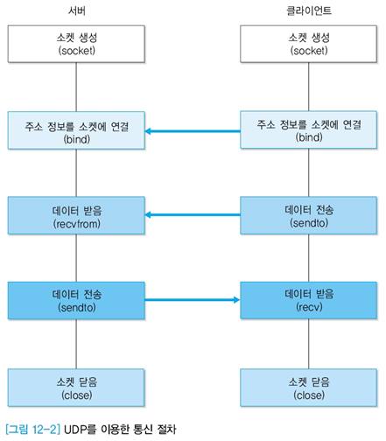
Wi-Fi Socket
OS interface
TCP 프로토콜 / UDP 프로토콜
통합 주소 체계

Slide 12
Wi-Fi Socket
Socket 함수
- s = socket (int domain, int type, int protocol)
- 매개 변수로 지정된 유형을 지원하는 소켓을 생성
- 생성된 소켓을 가리키는 소켓 디스크립터를 리턴
sock = socket(PF_INET, SOCK_DGRAM, 0
server.sin_family = AF_INET;
server.sin_addr.s_addr = htonl(INADDR_ANY);
server.sin_port = htons(TIME_PORT);
Server
server.sin_family = AF_INET;
server.sin_addr.s_addr = inet_addr(TIME_SERVER);
server.sin_port = htons(TIME_PORT);
sock = socket(PF_INET, SOCK_DGRAM, 0))
Client
source : http://cafe.naver.com/thingdue

Slide 13
Wi-Fi Socket
Bind 함수
- bind (int s, struct sockaddr *name, socklen_t *namelen)
- s가 가리키는 소켓에 자신의 소켓 주소를 부여함
- name: 바인드될 소켓 주소 값
server.sin_family = AF_INET;
server.sin_addr.s_addr = htonl(INADDR_ANY);
server.sin_port = htons(TIME_PORT);
bind(sock, (struct sockaddr *)&server, sizeof(server))
Server
client.sin_family = AF_INET;
client.sin_addr.s_addr = htonl(INADDR_ANY);
client.sin_port = htons(0);
bind(sock, (struct sockaddr *)&client, sizeof(client))
Client
source : http://cafe.naver.com/thingdue

Slide 14
Wi-Fi Socket
통신 연결
- 클라이언트가 자신의 주소를 전송
- 서버는 받아서 연결확인 메시지 전송
-> s가 가리키는 소켓에 자신의 소켓 주소를 부여함
-> name: 바인드 될 소켓 주소 값
strcpy(buf,server.sin_addr.s_addr);
sendto(sock, buf, sizeof(buf) + 1, 0, (struct sockaddr *)&server, server_len);
recvfrom(sock, buf, 256, 0, (struct sockaddr *)&server, &server_len);
Server
recvfrom(sock, buf, 256, 0, (struct sockaddr *)&client, &client_len);
Sytcpy(buf,”connect OK”);
sendto(sock, buf, strlen(buf) + 1, 0, (struct sockaddr *)&client, client_len);
Client
source : http://cafe.naver.com/thingdue

Slide 15
Wi-Fi Socket
Device Control
- 클라이언트에서 ON or OFF 선택
- 서버는 값 확인해서 ON or OFF
- Device ON, OFF 여부 확인해서 전송
- 클라이언트에서 Device ON/OFF 확인
if(buf[0]=='1') {
printf("Server : Got on\n");
mraa_gpio_write(led,1);
strcpy(buf," ON\n");
}
Server
printf("press key : LED on(1) OFF(0) ");
scanf("%s",buf);
sendto(sock, buf, sizeof(buf) + 1, 0, (struct sockaddr *)&server, server_len);
recvfrom(sock, buf, 256, 0, (struct sockaddr *)&server, &server_len);
printf("\nEdison LED %s", buf);
Client
source : http://cafe.naver.com/thingdue

Slide 16
#include <stdio.h>
#include <stdlib.h>
#include <string.h>
#include <sys/types.h>
#include <sys/socket.h>
#include <netinet/in.h>
#include <time.h>
#include <mraa/gpio.h>
#define TIME_PORT 5010
main()
{
int sock;
struct sockaddr_in server, client;
int server_len;
int client_len = sizeof(client);
char buf[256];
int buf_len;
sock = socket(PF_INET, SOCK_DGRAM, 0);
server.sin_family = AF_INET;
server.sin_addr.s_addr = htonl(INADDR_ANY);
server.sin_port = htons(TIME_PORT);
bind(sock, (struct sockaddr *)&server, sizeof(server));
mraa_gpio_context led;
led=mraa_gpio_init(10);
mraa_gpio_dir(led,MRAA_GPIO_OUT);
Server

Slide 17
while(1)
{
buf_len = recvfrom(sock, buf, 256, 0, (struct sockaddr *)&client, &client_len);
if(buf_len < 0)
exit(1);
if(buf[0]=='1') {
printf("Server : Got on\n");
mraa_gpio_write(led,1);
strcpy(buf," ON\n");
}
else if(buf[0]=='0'){
printf("Server : Got on\n");
mraa_gpio_write(led,0);
strcpy(buf, " OFF\n");
}
else {
printf("Server : Got wrong word \"%s\"\n",buf);
strcpy(buf, " ERROR\n");
}
sendto(sock, buf, strlen(buf) + 1, 0, (struct sockaddr *)&client, client_len);
}
mraa_gpio_close(led);
return MRAA_SUCCESS;
close(sock);
}
Server

Slide 18
#include <stdio.h>
#include <stdlib.h>
#include <string.h>
#include <sys/types.h>
#include <sys/socket.h>
#include <netinet/in.h>
#define TIME_SERVER "1.1.1.93"
#define TIME_PORT 5010
main()
{
int sock;
struct sockaddr_in server, client;
int server_len = sizeof(server);
char buf[256];
int buf_len;
server.sin_family = AF_INET;
server.sin_addr.s_addr = inet_addr(TIME_SERVER);
server.sin_port = htons(TIME_PORT);
sock = socket(PF_INET, SOCK_DGRAM, 0);
client.sin_family = AF_INET;
client.sin_addr.s_addr = htonl(INADDR_ANY);
client.sin_port = htons(0);
bind(sock, (struct sockaddr *)&client, sizeof(client));
Client

Slide 19
while(1){
printf("press key : LED on(1) OFF(0) ");
scanf("%s",buf);
buf_len = sendto(sock, buf, sizeof(buf) + 1, 0, (struct sockaddr *)&server, server_len);
buf_len = recvfrom(sock, buf, 256, 0, (struct sockaddr *)&server, &server_len);
if(buf_len < 0)
exit(1);
printf("\nEdison LED %s", buf);
}
close(sock);
}
Client

